Slide 1
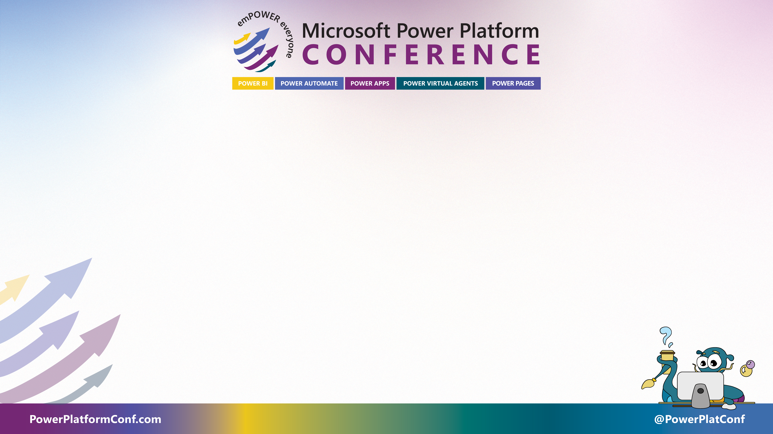
Power Platform Makeover: Designing Pretty, Performant and Intuitive Solutions
Notes:
Wifi, Admin issues, etc.
Lunch Passes

Slide 2

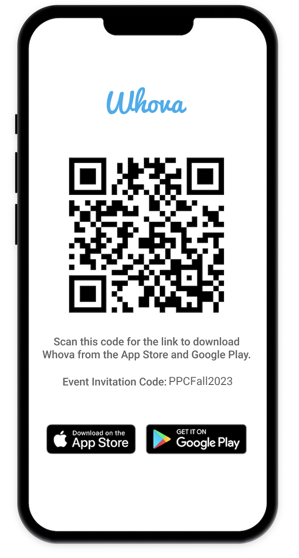
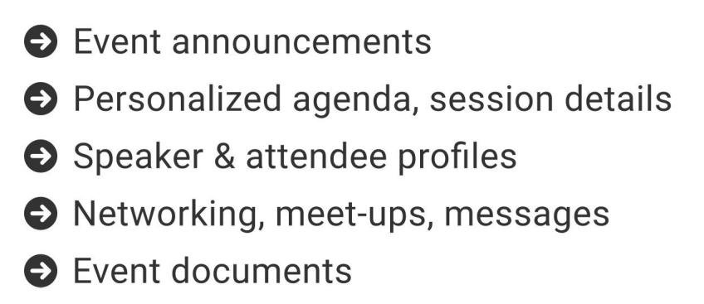
The official event app for the Microsoft Power Platform Conference – Fall 2023
Join the event app to access:
Event Invitation Code: PPCFall2023

Slide 3





About us
Luise Freese
Kristine Kolodziejski
Independent M365 & Power Platform consultant
Dual MVP in M365 Development & Business Applications
M365princess.com
Loves community, stickers, the number 42
@LuiseFreese
Based in London, UK,
Technical Architect,
Microsoft MVP,
#PrinCSS
Racer 🏎️🏁 Gamer 🎮 drummer 🥁 & nerd
Notes:
Mandatory this is us slide

Slide 4


About us
Hugo Bernier
David Warner
Community Program Manager, Microsoft
Toronto
@bernierh
Community Program Manager, Microsoft
Los Angeles
@DavidWarnerII
Notes:
Mandatory this is us slide

Slide 5
THE Link
https://github.com/LuiseFreese/PowerApps-Masterclass
WIFI: PPC 2023
PWD: PPC2023!!

Slide 6
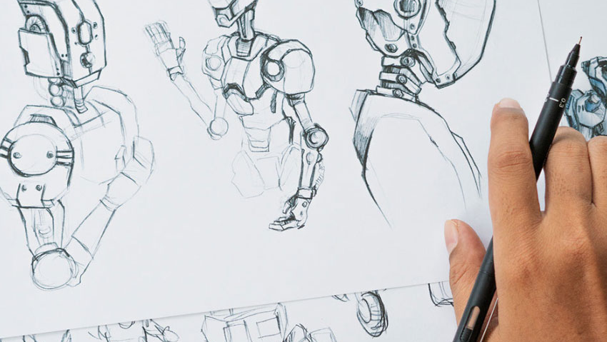
Don’t forget animation Hugo & David

Slide 7

What is performance?

Slide 8
Performance is not something that we can magically apply after we build an app.

Slide 9

Performance is a result of valuable architecture decisions and good coding practices

Slide 10

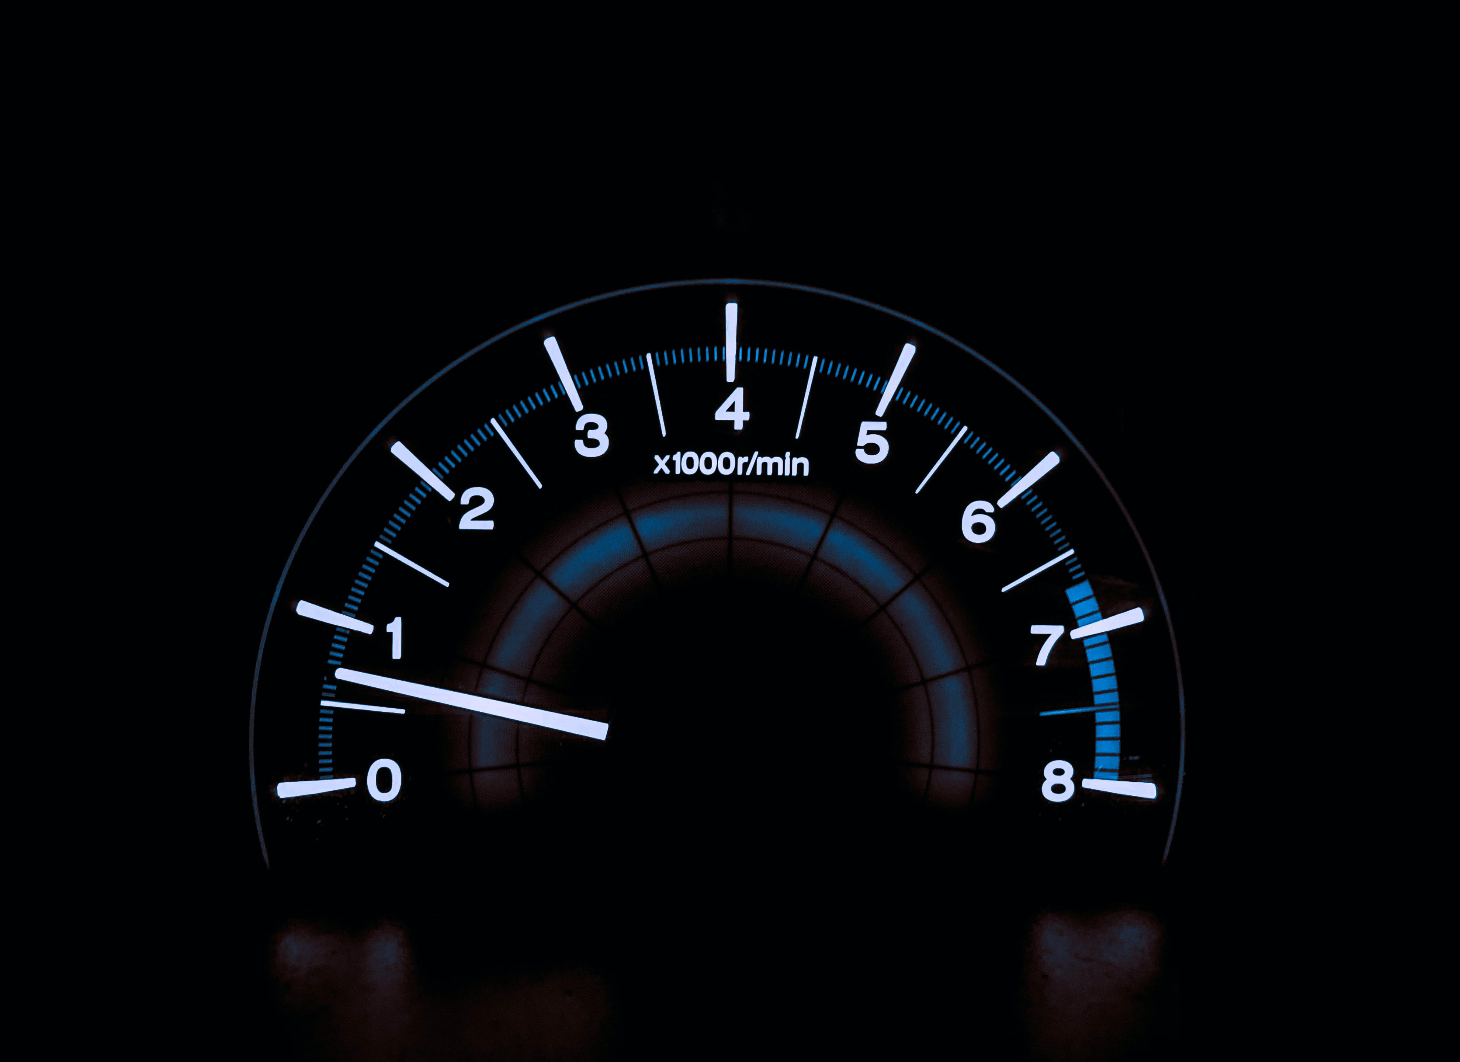

Why would we care?
They are spoiled from their experiences with fast websites
Users expect fast apps
Performance and acceptance go hand in hand
Notes:
The average time a person will wait for a web page to load before leaving is 3 seconds – same applies to apps
Lack of performance is usually a result from bad coding practices and poor design choices
Performance is a result

Slide 11

Architecture decisions
App scope
Database
App design
Coding practices
Dependencies
Media
Notes:
Limit data connections
The more, the worse
Limit the number of controls
Components FTW
Optimize the OnStart property
ClearCollect
Concurrent
Use App.StartScreen
Cache lookup data

Slide 12
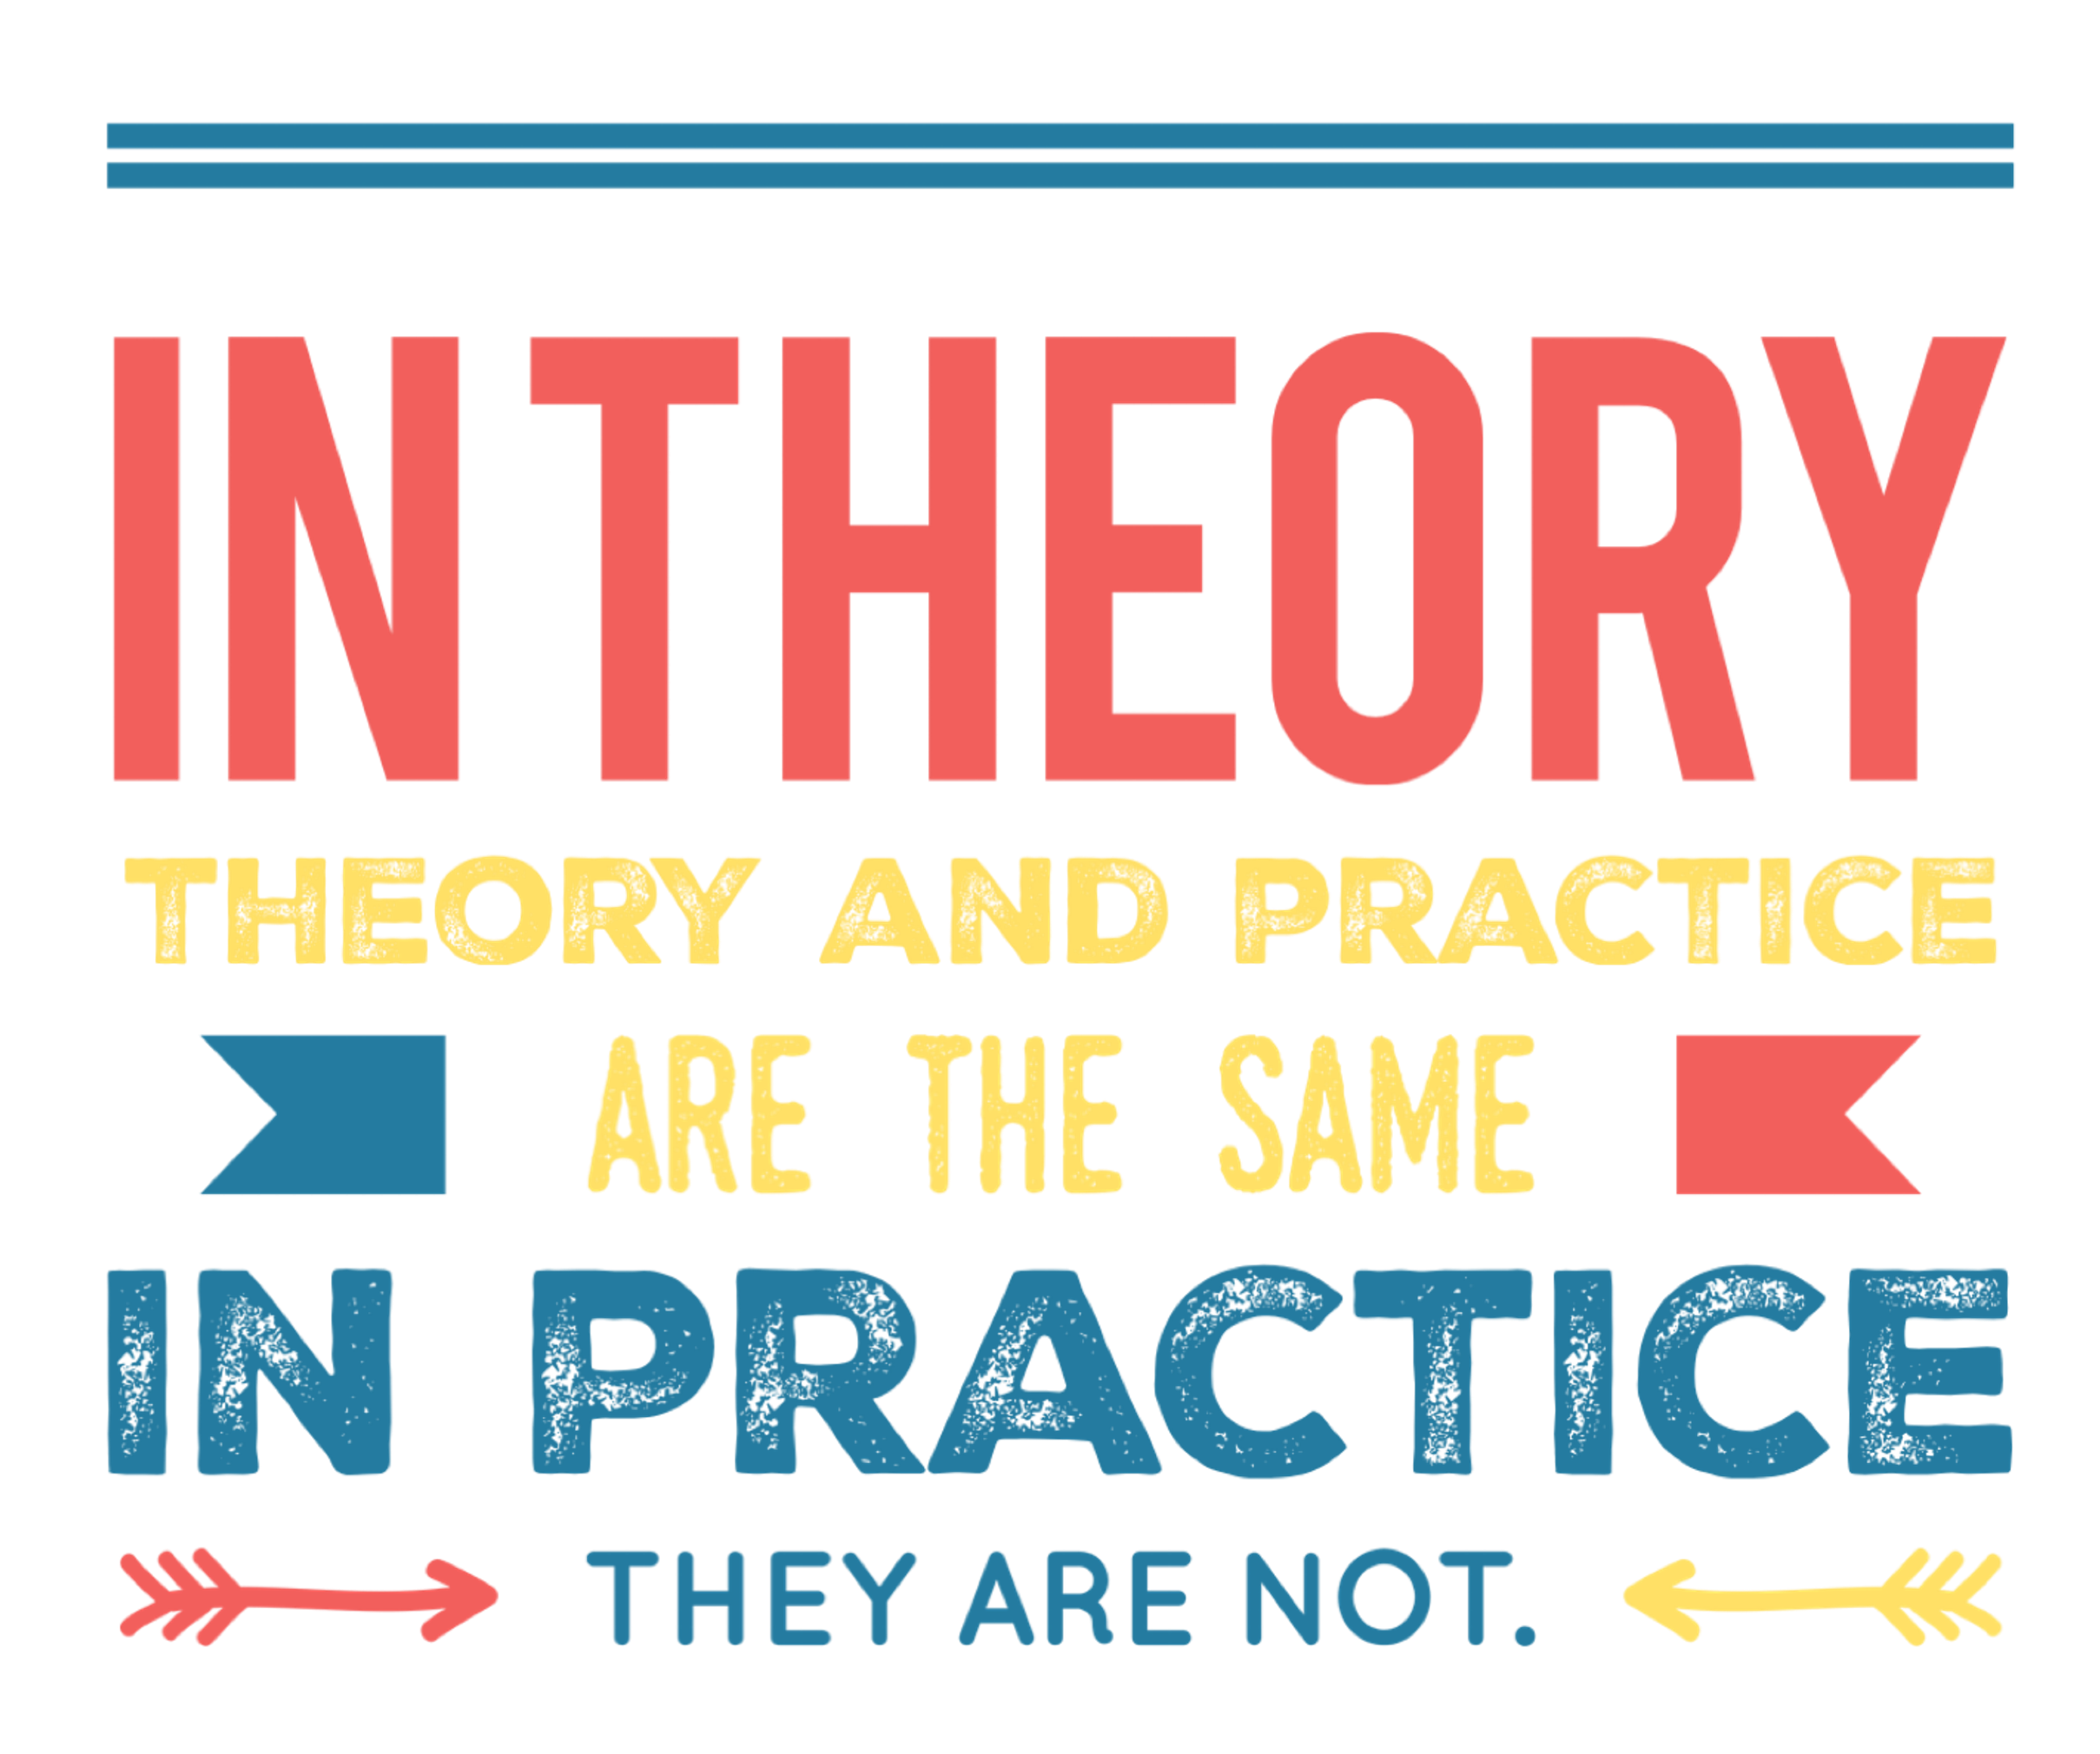
Databases
Technically, you can connect your Canvas app to almost every data
Practically, you shouldn’t.
Notes:
Understand canvas app execution phases and data call flow - Power Apps | Microsoft Docs

Slide 13

Understand how data flows

Slide 14
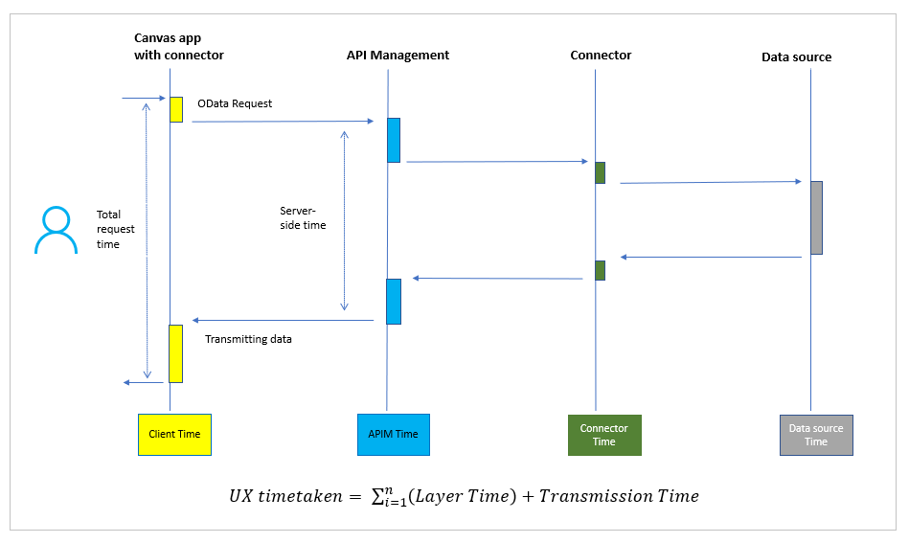
Typical data call flow
Data request travels several server-side layers until it reaches the target data source
Then it returns data to the client, passing again these layers
Notes:
Understanding how OData requests travel in canvas apps can help you to optimize your canvas app performance and your back-end data sources:
Data request travels several server-side layers until it reaches the target data source (such as Azure SQL or SharePoint), then it returns data to the client.

Slide 15
Typical data call flow
Notes:
Understanding how OData requests travel in canvas apps can help you to optimize your canvas app performance and your back-end data sources:
Data request travels several server-side layers until it reaches the target data source (such as Azure SQL or SharePoint), then it returns data to the client.

Slide 16
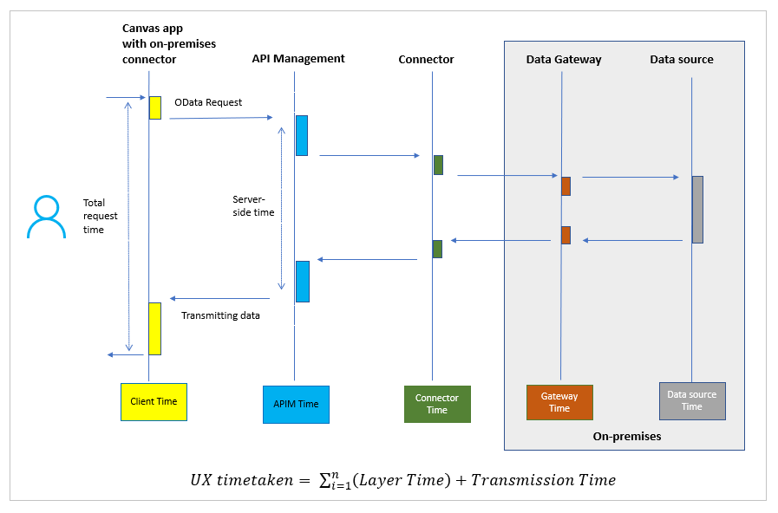
Data call flow with on-prem data gateway
Slowest option
Data needs to travel through
APIM
the connector,
the data gateway
to the data source - and then back
Tipp: Consider to move on-prem data to cloud

Slide 18
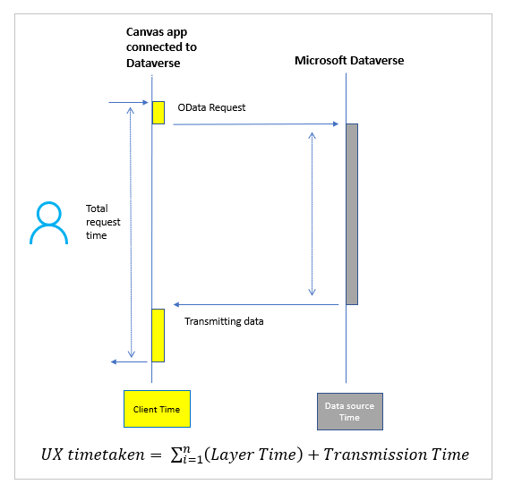
Data call flow with Microsoft Dataverse
Connect directly without passing through Azure API Management
no connector, no gateway
Fastest option

Slide 20
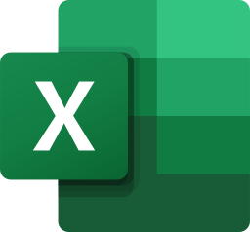
Excel
Just don’t. Your datasource shouldn’t be a spreadsheet
Issues:
File needs to be in your OneDrive
Table can’t have any formulas
App can’t be used if the file is opened (it’s locked)
No delegation – which means heavy data processing is done in the app – which makes it slow

Slide 21

SharePoint
Issues with
complex column types
attached files
large lists (items)
many columns
Tipp: Turn on explicit column selection

Slide 22
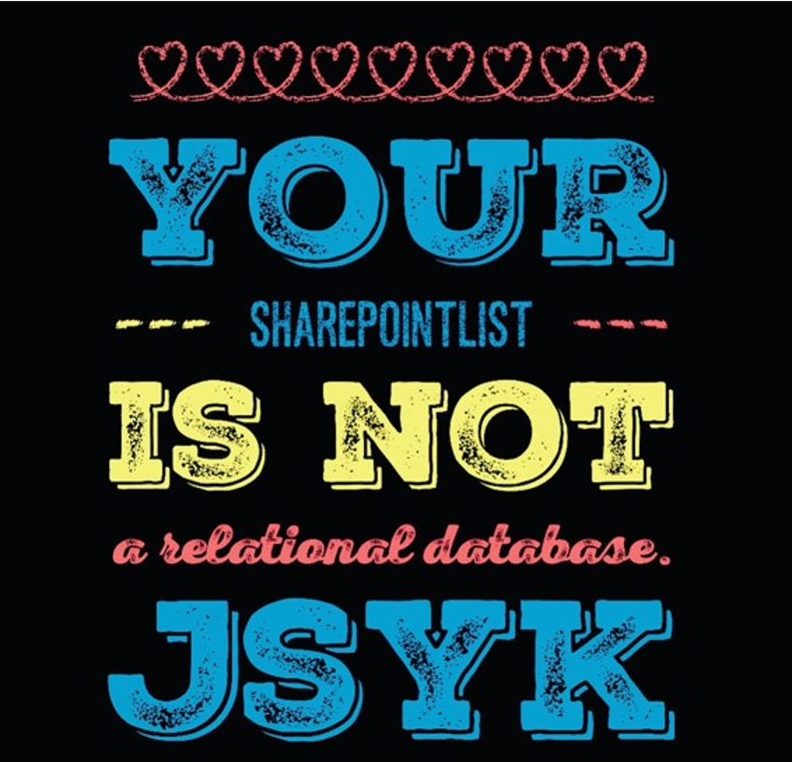
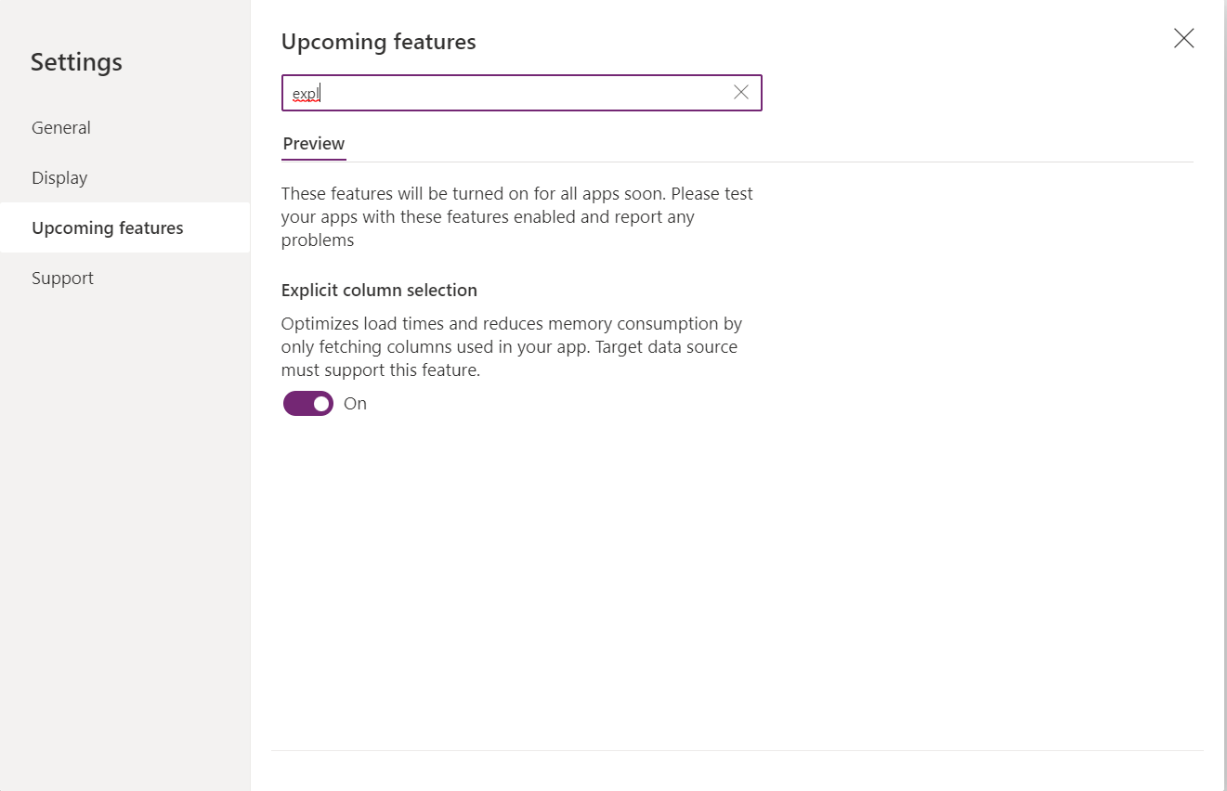
SharePoint
Tipp: Turn on explicit column selection
Notes:
To turn on the explicit column selection feature on the canvas app, go to Settings > Upcoming features > Preview, and then turn on the Explicit column selection toggle.

Slide 23

Azure SQL
Choose right service tier to avoid throttling issues
Excessive geographical distance affects
Latency
reduced throughput
lower bandwidth
packet loss
Use views instead of tables to limit the amount of data that needs to be processed

Slide 24

Dataverse
By far! The most performant and secure database
Use views instead of entire tables

Slide 25
Discussion: SharePoint vs Dataverse

Slide 26





Discussion: SharePoint vs Dataverse
When to use whathat
users
complexity

Slide 27
App Design – Do’s
Use OnStart property wisely
🙄 While OnStart code is running, users will continue to see the app splash screen and a “Getting your data” message
💡 Only to initialize the app
😇 Resist temptation to put data initialization calls there
Reuse everything
Components > controls (DRY)
Galleries for everything that needs to be repeated
Store error messages in variables
Handle user interaction smart
🚀Work locally with your data → ClearCollect()
🤝Execute more than one request simultaneously → Concurrent()
⚡ Make searching faster → Set Delay output: true
Notes:
Some of your data or API calls will be expensive or time-consuming. Long execution times will affect your perceived performance. Here are some tips:
Current screen, OnSelect of a button: Navigate(TheNextScreen)
NextScreen, OnVisibleThen, on the next screen make the calls in the OnVisible property.

Slide 28
App Design - Don’ts
Avoid non delegable functions
First(Filter(‘MyData’, Startswith(Customer, “L”)) → LookUp(colmydata, StartsWith(Customer, “L”).Customer
Don’t make expensive calls while user is staring at the screen
Unpopular opinion: Don’t use a loading message box or spinner
Don’t inherit values of properties from controls that are located on other screens
Notes:
Some of your data or API calls will be expensive or time-consuming. Long execution times will affect your perceived performance. Here are some tips:
Current screen, OnSelect of a button: Navigate(TheNextScreen)
NextScreen, OnVisibleThen, on the next screen make the calls in the OnVisible property.

Slide 29
Limit package size
Break up too complex apps
Delete media that is not needed
SVG > PNG
Delete unused screens

Slide 30

Notes:
Some of your data or API calls will be expensive or time-consuming. Long execution times will affect your perceived performance. Here are some tips:
Current screen, OnSelect of a button: Navigate(TheNextScreen)
NextScreen, OnVisibleThen, on the next screen make the calls in the OnVisible property.

Slide 31
Some ideas for galleries
Navigation
Tabs
Stepper dots
Process bars

Slide 32
Intro to components
Components are serve DRY
Awesome, but underused
Proper planning can save hours or even days of development time
Undocumented components won't serve the components goal of being reusable, but will furthermore increase technical debt.

Slide 33
Intro to components: Start with docs
Name - make it meaningful
stick with a convention
This is makes it easier for makers to find the right component
Description – what shall it do?
display information
gather data from a user
facilitate how users interact with UI?
Context – where shall it run?
Standalone?
Host app like Teams, SharePoint?
Desktop, mobile, Kiosk device?
Use cases – whom does it serve

Slide 34
Intro to components: Design considerations
Colors:
A good practice is to layout a color palette for your component or your component library and then stick to this.
Use https://coolors.co
To harmonize the look you can use the 60-30-10 rule
60% should be a primary color (dominant),
30% should be a secondary color (supporting),
10% should be an accent color
Shapes & Sizes:
example rounded corners?
border thickness, width and height of your component
media such as images, icons etc.
Notes:
https://uxplanet.org/5-simple-tips-on-using-color-in-your-design-40916d0dfa63

Slide 35
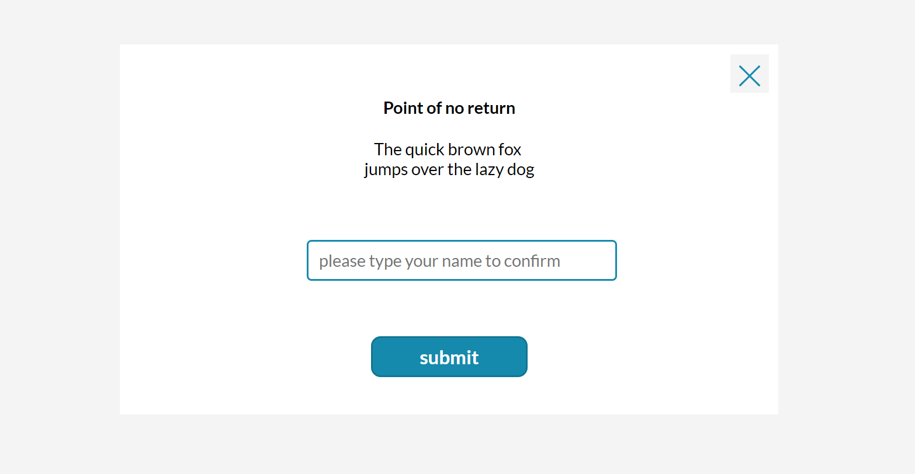
Intro to components: example: pop up

Slide 36
Intro to components: Add flexibility with input properties
Define input properties for the colors you want to use: `primaryColor`, `secondaryColor`, `accentColor`
Assign your color palette values to them as default values
Create input properties for radius of buttons, standard width or height of controls you use, and more.
The goal is to avoid hard coded values as you don't want to go over the entire component over and over just because someone requests 'just a tiny change' 🙃
Notes:
https://uxplanet.org/5-simple-tips-on-using-color-in-your-design-40916d0dfa63

Slide 37
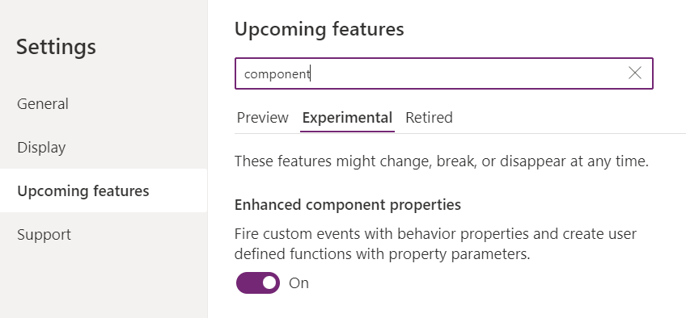
Intro to components: Fire custom events with Event properties
Add an Event property `onClose` (boolean) to our component
Add an `X` icon to the component
Assign the property to the **OnSelect** of the `X` icon
In your component instance, set the **OnSelect** property of your component to `Set(isCmpVisible, false)`
In your component instance, set the **Visible** property of your component to `iscmpVisible`
Notes:
https://uxplanet.org/5-simple-tips-on-using-color-in-your-design-40916d0dfa63

Slide 38
Intro to components: Content
Define input properties for every text, number, table, or image being displayed, such as
mainButtonContent
labelHeaderContent
labelBodyContent
Notes:
https://uxplanet.org/5-simple-tips-on-using-color-in-your-design-40916d0dfa63

Slide 39
Intro to components: return values to your app with output properties
If users interact with our components and we want to know *what* they did, we will need to return values from our component to the app. We do this with output properties.
For example, if our component contains a TextInput control and we want to know the **Text** property of that in our app, we will need to create an output property, hook that to `TextInput.Text` and then use the Output property in the app to return that value.
Notes:
https://uxplanet.org/5-simple-tips-on-using-color-in-your-design-40916d0dfa63

Slide 40

Build a component: modal window (1)
Notes:
https://uxplanet.org/5-simple-tips-on-using-color-in-your-design-40916d0dfa63

Slide 41
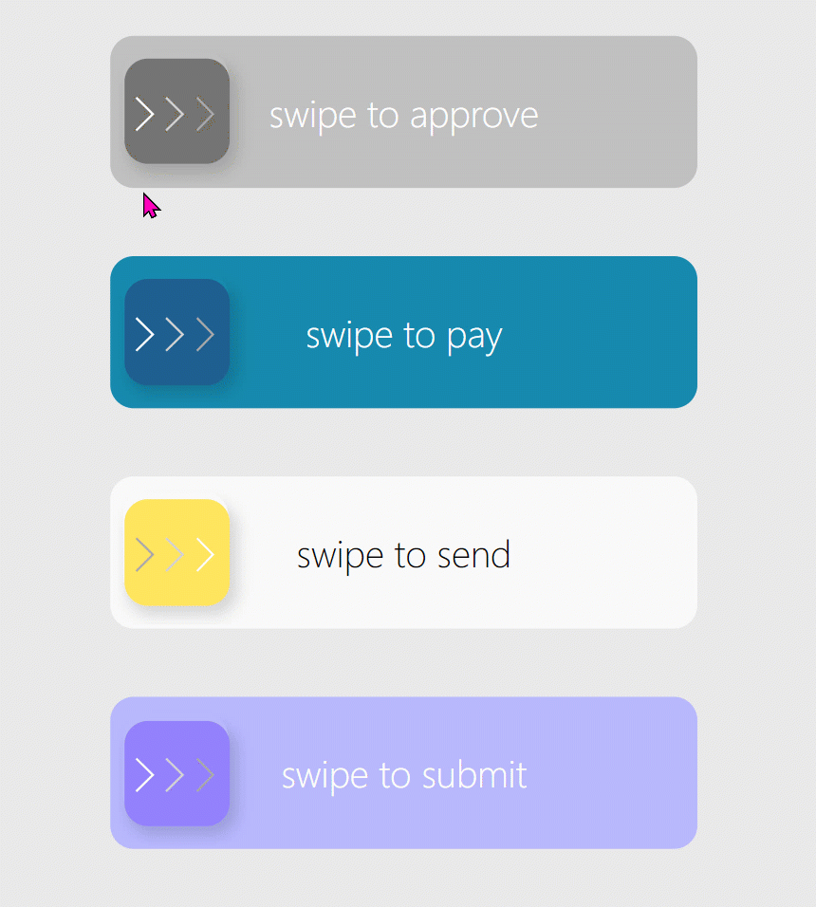
Build a swipe right component (2)

Slide 42
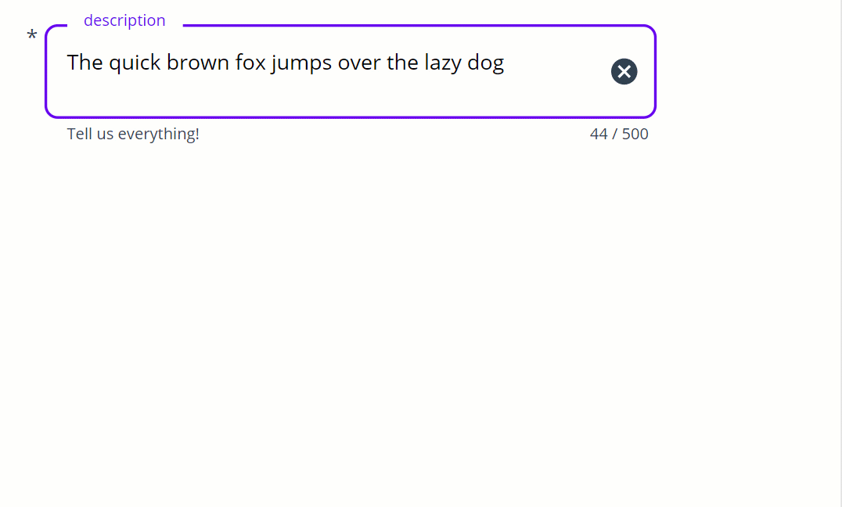
Build an auto height textinput (3)

Slide 43
UI Design

Slide 44
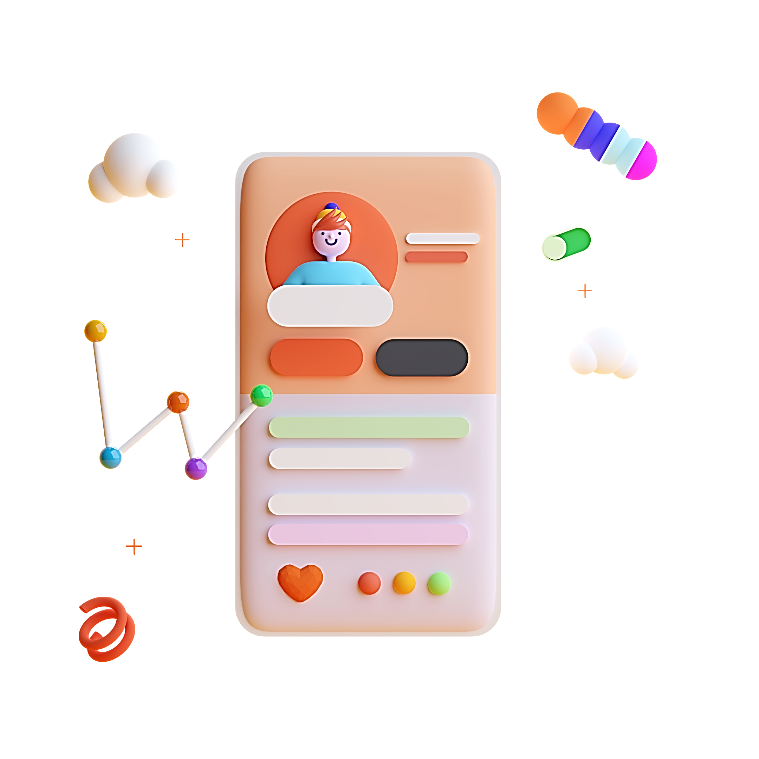
What is UI design?
designing visual interfaces for machines and software that are memorable and meaningful

Slide 45
‘Moving rectangles for a living’

Slide 46

Design principles

Slide 47
Design principles
C
R
A
P

Slide 48
Design principles
C
ontrast
R
epetition
A
lignment
P
roximity

Slide 49
‘Hey Kristine, can you build
this quick Canvas App?’
👋
👋
‘Sure, let me just do some user research, write some case studies, do some wirefames, iterate them with you and then I’ll start building!’
👋
👋
👋

Slide 50
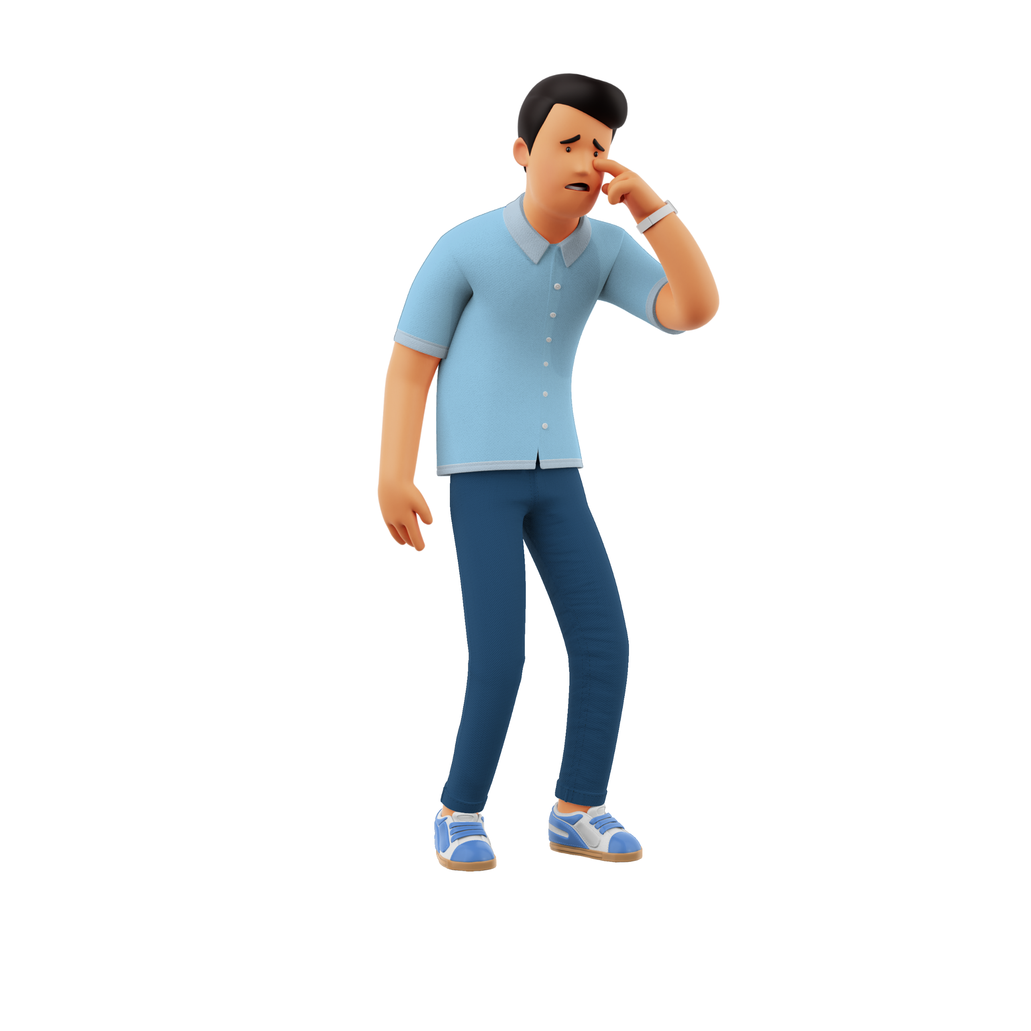
‘I’m not very creative…’

Slide 51
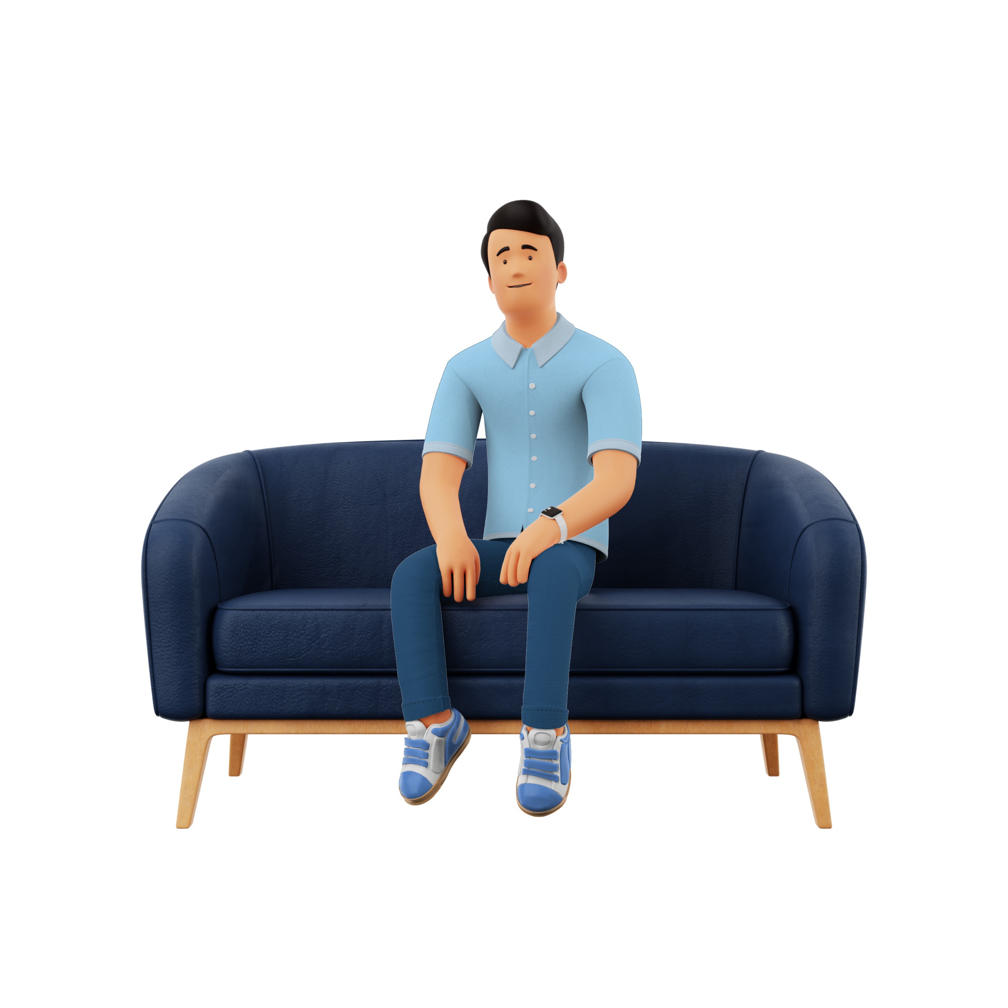
I’ve got you 😎

Slide 52
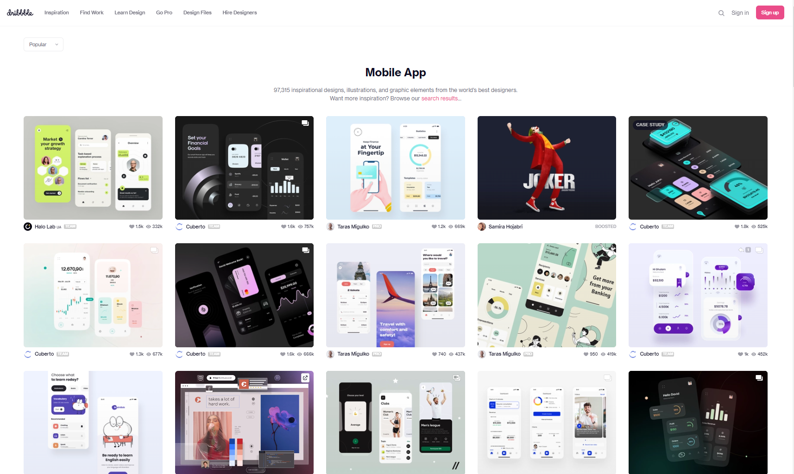
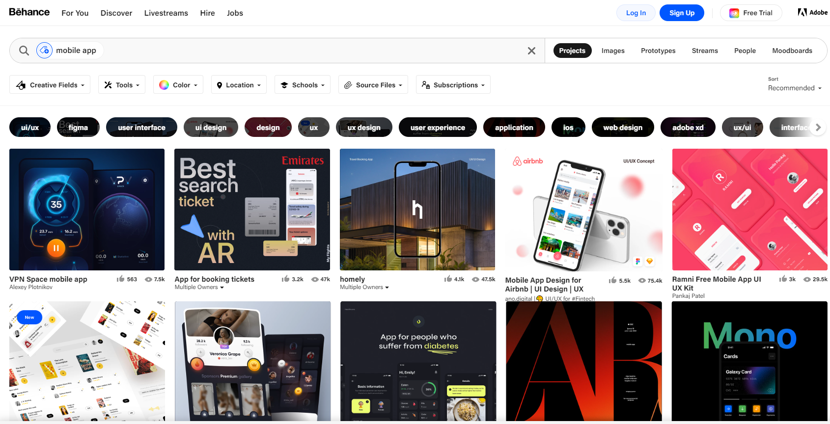
Inspiration everywhere ✨
Dribbble
Behance

Slide 53
Typography

Slide 54
Typography
Simple = legible
Hello
Hello
Hello
Hello
Hello
Hello
Hello
Hello
Hello
Hello
👎
👍

Slide 55
Typography
Cursive and decorative fonts are a no go.
Welcome to my application
Welcome to my application.
👎
👍

Slide 56
Typography
Emphasize text to create contrast.
Welcome, Kristine.
Welcome, Kristine.
👎
👍

Slide 57
Typography
Do not use underlined text for plain text.
Welcome, Kristine.
Welcome, Kristine.
👎
👍

Slide 58
Typography
Left aligned text is more legible.
Pavlova is a meringue-based dessert. Originating in either Australia or New Zealand in the early 20th century, it was named after the Russian ballerina Anna Pavlova. Taking the form of a cake-like circular block of baked meringue, pavlova has a crisp crust and soft, light inside.
Pavlova is a meringue-based dessert. Originating in either Australia or New Zealand in the early 20th century, it was named after the Russian ballerina Anna Pavlova. Taking the form of a cake-like circular block of baked meringue, pavlova has a crisp crust and soft, light inside.
👎
👍

Slide 59
Icons

Slide 60
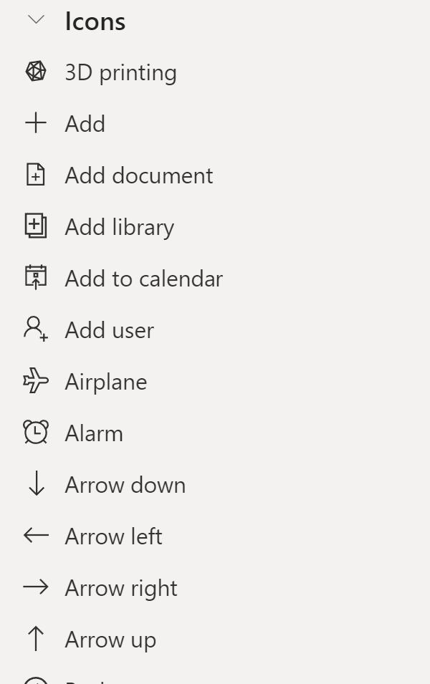
Icons

Slide 61
Icons

Slide 62


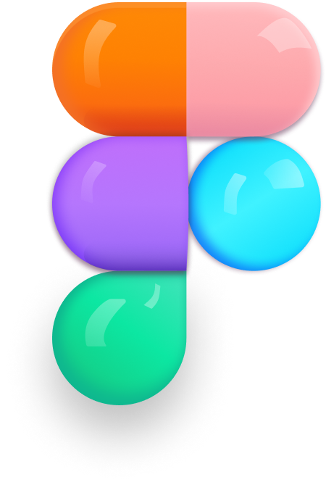
Icons

Slide 63
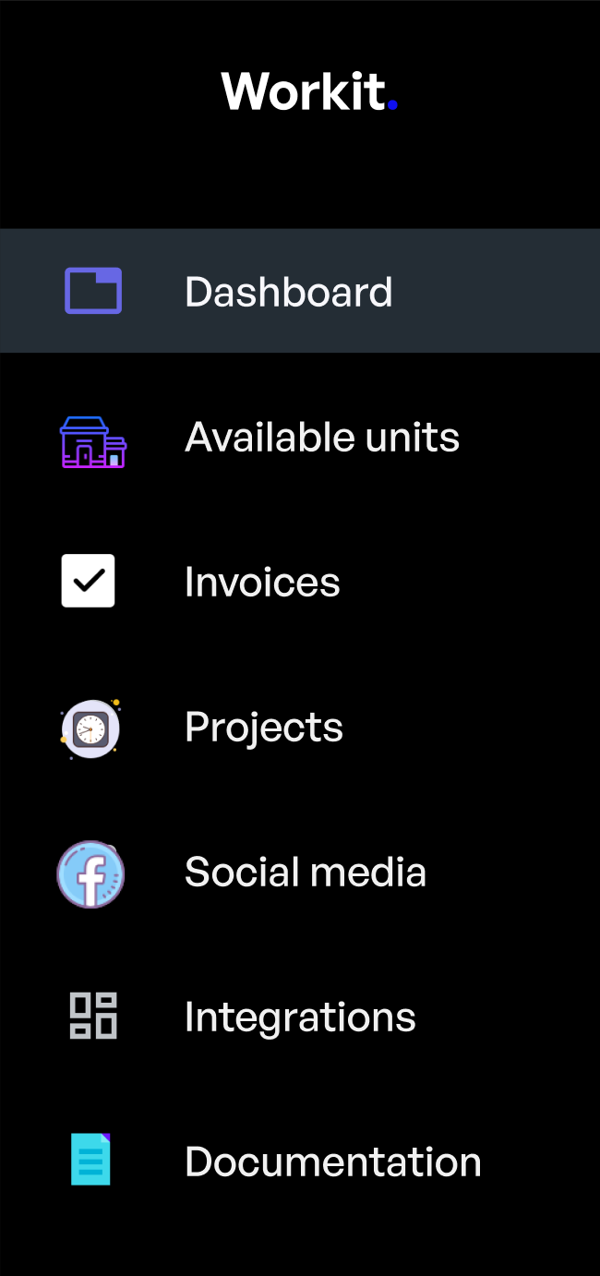
Icons
Only use icons from one icon set to keep you design consistent.

Slide 64




Icons
Select one style and use it consistently.

Slide 65
UX Design

Slide 66
UX Design
to plan how something looks and works to make the activity of using it easy and enjoyable

Slide 67

What is good UX design?
Think of the last app you downloaded on your mobile…

Slide 68
Does UX even apply to low code?
Kind of...
Let’s explore

Slide 69
Traditional UX process
User research
Analysis
Validation
implementation

Slide 70
6 principles to keep in mind
Useful
Usable
Desirable
Memorable
Accessible
Credible

Slide 71
Let’s see how these apply!

Slide 72


Accessibility

Slide 73




Mind-blowing stats
15%
73%
71%
70%
of the world population has a permanent disability
of disabled users experienced issues with apps and websites
of those users will also click away from your app/website if it’s problematic
of all websites checked for accessibility had major issues

Slide 74
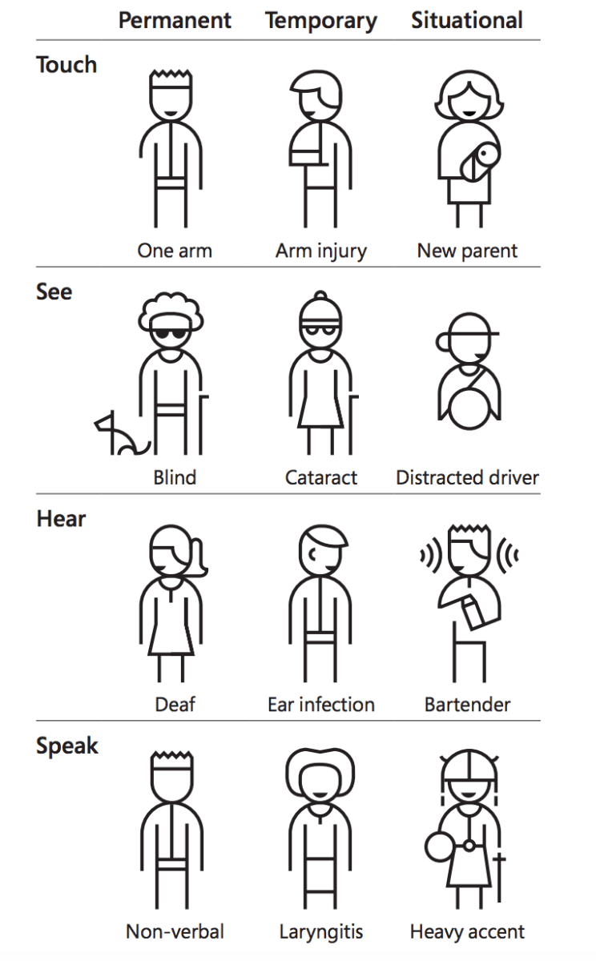
Types of accessibility needs

Slide 75
Accessibility in Power Platform
Color contrasts
Easy to understand
Alt text
Keyboard navigation
Logical layout
Accessibility checker
Focused borders

Slide 76
Accessibility standards
WCAG 2.2

Slide 77
Accessibility standards
WCAG 2.2
Web Content Accessibility Guidelines
https://www.w3.org/WAI/standards-guidelines/wcag/

Slide 78





Measuring accessibility
Windows tools
Dev tools
WCAG website
Plugins

Slide 79
Honourable mention
Accessibility checker

Slide 80


Get started
+

Slide 81

‘But accessibility makes my apps ugly 🙄’

Slide 82
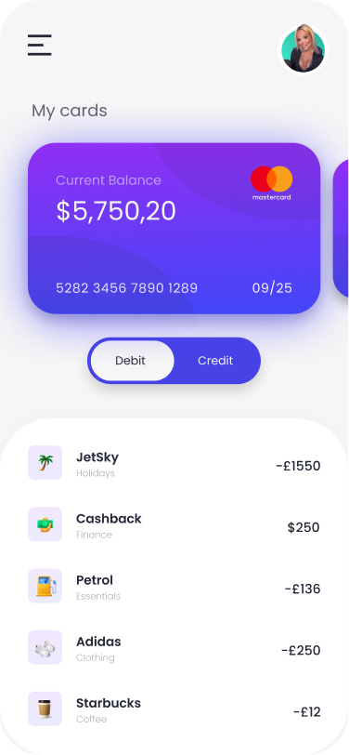
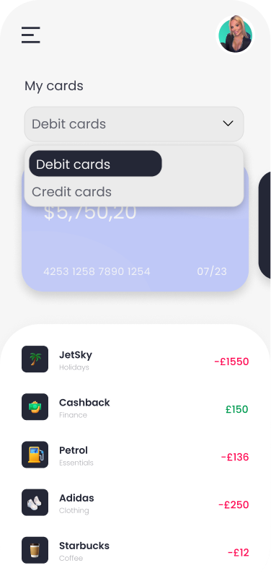
Ugly apps galore🤔
Which one is more accessible?

Slide 83




Accessibility IS good design
Improved experience for EVERYONE
More user-friendly
Cleaner and simpler design
Easier to fix

Slide 84
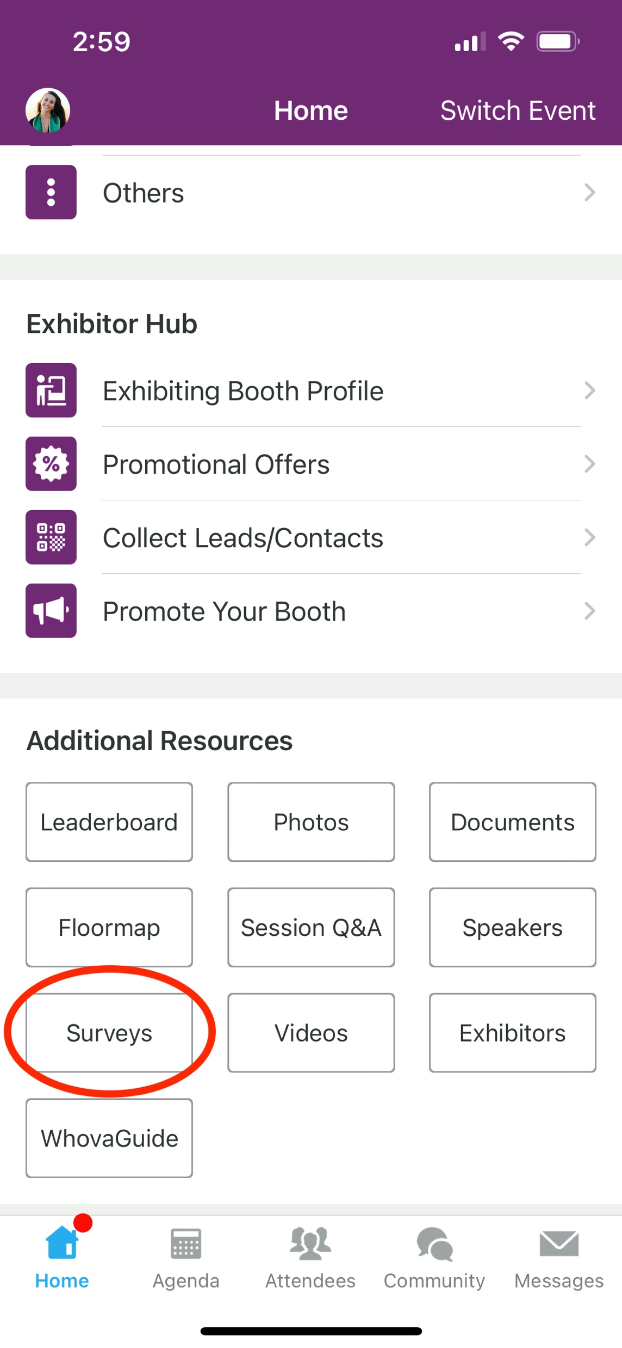
Session Feedback Surveys
We really want to hear from YOU!
In the pursuit of making next year’s Microsoft Power Platform Conference even better, we want to hear your feedback about this session.
Here’s How -
Simply go to the Whova App on your smartphone
Scroll down on the Microsoft Power Platform Conference Homepage to ‘Additional Resources’ to click “Surveys’.
Click Session Feedback.
Scroll down to find this session title.
Complete the session feedback survey.
Finally, click ‘Submit’
It’s just that easy!

Slide 85
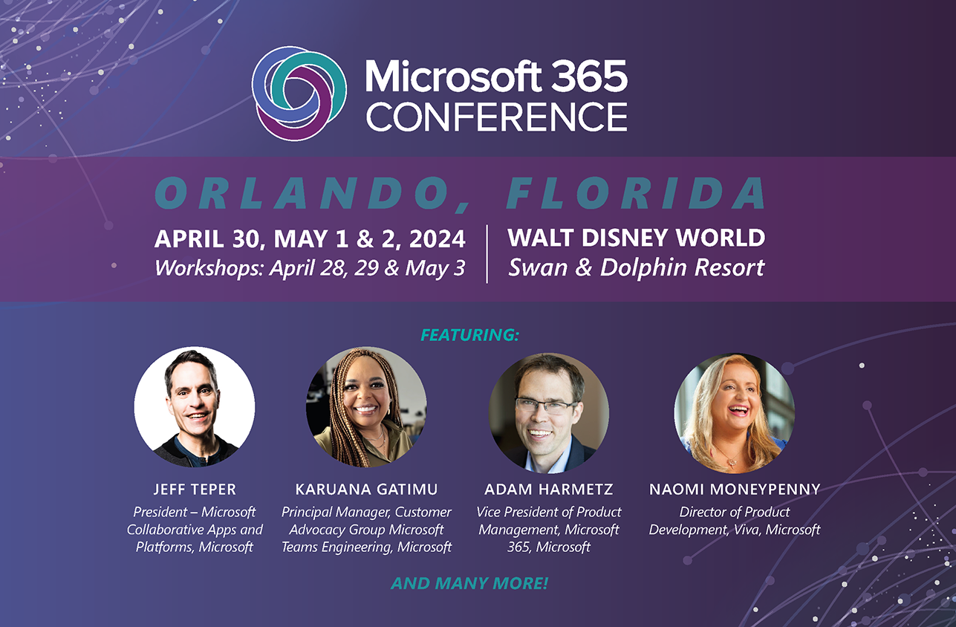

Slide 86
